Slide 1

Notes:
Welcome New Quantico Employees. I am _______________________ , a member of the Safety Division.
Our goal is to see that you leave Quantico each day in at least the same condition as when you arrived; hopefully better.

Slide 2
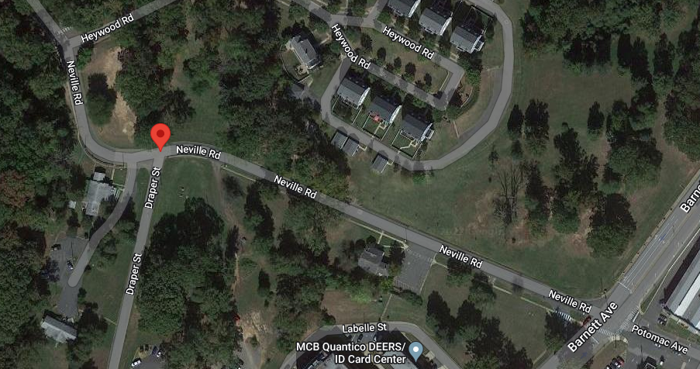
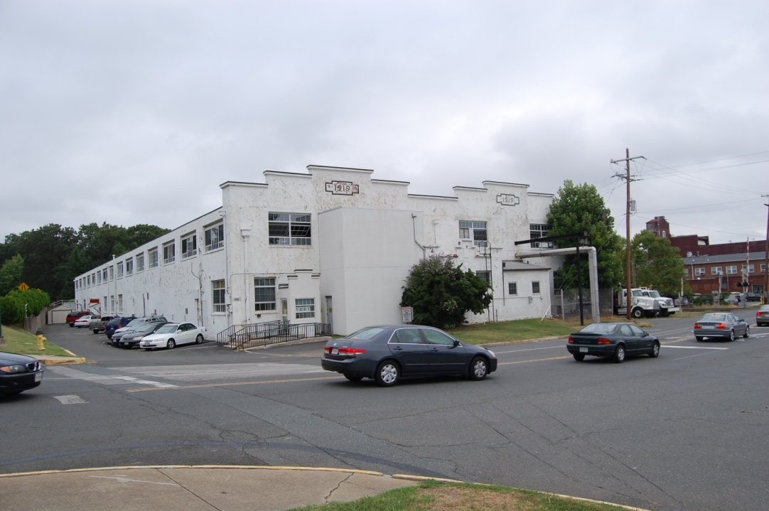
Safety Division Locations
Main Office (General information)
122 Neville Road
(703) 784-2866
Training Branch
Supervisor: Lynn Terry
(703) 432-1127
Bldg. 1001
Headquarters Branch (HQ)
Director: Kurt Vimont
Deputy Director: John Abney
Notes:
The members of Safety Division are located in several different places on Base. The Director, Ass’t Director and the Inspection Section are located at 122 Neville Road, turn Left just after you pass Draper Street if you’re coming from Barnett Avenue

Slide 3
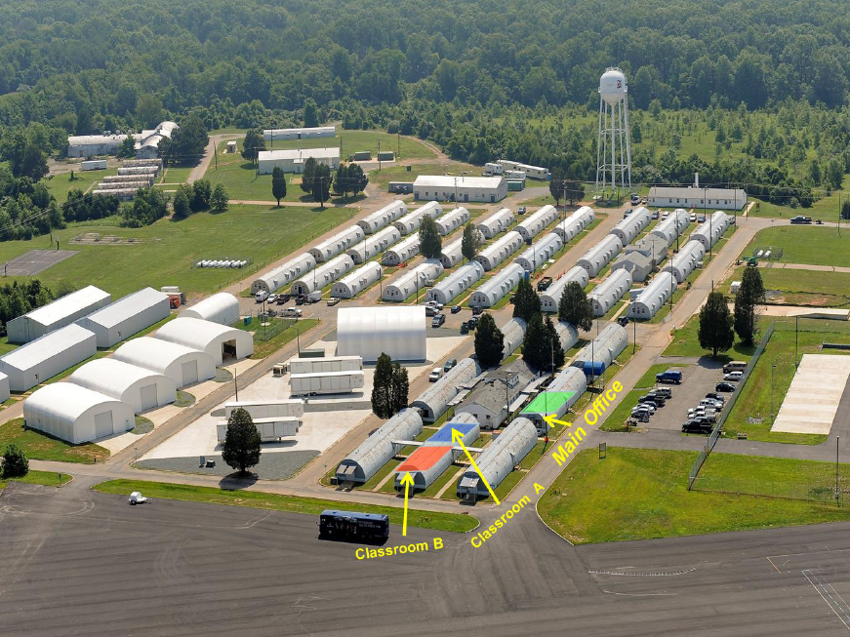
Traffic Safety
Branch Manager: Stephen DeJesus
(703) 432-0195
Bldg. 26133
Main Entrance
Notes:
Our Traffic Safety Branch is located at Camp Upshur, which is located on the far north-western edge of Base. TS Branch specializes in licensing and training for operating all types of government vehicles and the specialized license endorsements required. They also provide Basic and Advanced motorcycle instruction according to MSF standards.

Slide 4
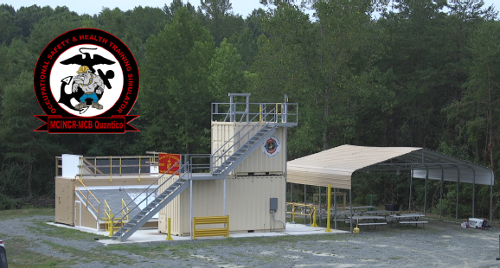
Training Simulator
Lead: Andre Thompson
(703) 432-1219
Bldg. 27413 A
Camp Upshur

Slide 5
What a Safety Program Includes:
A safe working environment increases efficiency, reduced hazards, prevents accidents, and reduces lost manpower
What does Base Safety do for you?
Base Safety provides the following Programs:
  Program Needs Assessment
  Conduct Safety Inspections
  Establish, coordinate, manage and provide resources for the following
    Occupational Safety & Health Program
    Traffic Safety Program
    Recreation Off-Duty
    Explosive Safety
  Investigate and document all reports of unsafe or unhealthful work conditions
  Hazard Assessments
  Subject matter expertise and consultation for program elements
  Support Military Operations and Training
  Provide Safety Promotional Material
  Provide Safety training
  Collaborate with other installations and Organizations to support the mission
  All in accordance with the MCO 5100.29C

Slide 6
SUPERVISOR RESPONSIBILITIES
Employees who exercise supervisory functions shall, to the extent of their authority, furnish employees employment and a place of employment which are free from recognized hazards that are causing or are likely to cause death or serious physical harm.
They shall also comply with the occupational safety and health standards applicable to their agency and with all rules, regulations, and orders issued by the head of the agency with respect to the agency occupational safety and health program.
Supervisors must provide a workplace hazard briefing that must include:
Fire Safety & Reporting
Hazard Identification & Reporting
Site Specific Hazardous Material
Identify the proper PPE to be worn
Interim Life Safety Measures
Hazardous Communication (SDS)
Ensure that all work centers using HM shall review and post, standard operating procedures for hazardous material management
29 CFR 1960.9 Subpart B

Slide 7

EMPLOYEE RIGHTS AND RESPONSIBILITIES
YOUR RIGHTS:
As a Marine Corps employee, you have the right to:
Participate in Safety and Health Program
Have access to records and documents
Report Unsafe/Unhealthful conditions
Freedom from fear of reprisal
YOUR RESPONSIBILITIES:
To comply with all OSHA, and Department of the Marine Corps Occupational Safety and Health standards, policies and directives
To use appropriate personal protective and safety equipment provided by the Command
To Report Unsafe/Unhealthful Work Environments and Conditions
To report all Mishaps, Near Misses and Property Damage
29 CFR 1960.10(a)(b)(c)(d)
Notes:
1960.10(a)
Each employee shall comply with the standards, rules, regulations, and orders issued by his/her agency in accordance with section 19 of the Act, Executive Order 12196, and this part which are applicable to his/her own actions and conduct.
1960.10(b)
Employees shall use safety equipment, personal protective equipment, and other devices and procedures provided or directed by the agency and necessary for their protection.
1960.10(c)
Employees shall have the right to report unsafe and unhealthful working conditions to appropriate officials.
1960.10(d)
Employees shall be authorized official time to participate in the activities provided for in section 19 of the Act, Executive Order 12196, this part, and the agency occupational safety and health program.

Slide 8
REPORTING UNSAFE UNHEALTHFUL WORKING CONDITIONS
Reporting Requirements:
Hazardous, Unsafe/Unhealthful Working Conditions, and Unsafe Actions or Culture
Report Unsafe/Unhealthful Working Conditions by the following Chain of CMD:
First - Employees Oral report to Supervisor (Supervisor submits unsafe/unhealthful in ESAMS)
Second - Safety Representative(s)
Thirdly - Base Safety Office
Lastly - Any-Mouse Report
Any-Mouse Reports, it is sometimes necessary to file an Any-Mouse report IF your concerns are not addressed by your Chain of Command in a reasonable time frame. However, because We at Base Safety take each concern very seriously it is unlikely that you will need to use this last resort.
MCO 5100.29C Vol 9

Slide 9
WHAT IS A MISHAP?
A mishap is an unplanned or unexpected event or series of events, that results in damage to DoD property; work-related illness to DoD personnel; injury to on- or off-duty DoD military personnel; injury to on-duty DoD civilian personnel; or damage to non-DoD property or injury or illness to non-DoD personnel, caused by DoD activities.
For purposes of DON safety reporting, events that meet the above criteria must also meet the minimum damage and injury or illness thresholds of a Class D mishap to be considered a mishap.
MCO 5100.29C Vol 9 Appendix A

Slide 10
WHAT IS A NEAR MISS?
When a more severe injury, damage to property or degraded mission was avoided by chance.
The Benefits of reporting Near-Misses
Accurately capture changing facility conditions as well as human behaviors
Provides a platform for each employee to be involved
Provides data to capture/trend data and address unsafe conditions/actions
Identifies shortfall in processes, PPE or training
If managed effectively, it help prevent future injuries or damage to equipment or property
Fosters a healthier culture of reporting within the command.
Encourages greater process compliance and adherence to published standards
MCO 5100.29C Vol 9, Appendix A

Slide 11
HOW TO REPORT A MISHAP OR NEAR MISS
HOW TO REPORT A NEAR MISS or MISHAP:
Report a Mishap or Near Miss in order by the following Chain of Command
First - Employees Oral report to Supervisor IMMEDIATLEY
Second - Work Center Safety Rep(s) IMMEDIATLEY IN ABSENCE OF SUPERVISOR
Third - Base Safety Office during normal business hours (0630 – 1730).
Supervisors will initiate mishap report in ESAMS
MCO 5100.29C Vol 9

Slide 12

General User’s Information
Enterprise Safety Application Management System (ESAMS) is an IT system used by all Marine Corps Base Quantico (MCBQ) personnel. It is used for the following:
  Medical Surveillance Monitoring
  Occupational Safety specific training
  Mishaps, Near Miss and Property Damage Reporting
  To assign, complete and Occupational Safety training
  Trend Analysis
  Evaluate Program Compliance
Every employee who works for Quantico Base is required to have an ESAMS account. An ESAMS account cannot be created without a DoD ID# which is located on the back of your CAC card.
Once you receive your card contact Safety Division office at (703) 784-2866, one of the Safety Specialist will create your account and assign the required core, duty/tasks (training).

Slide 13
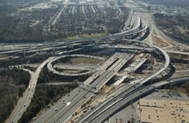
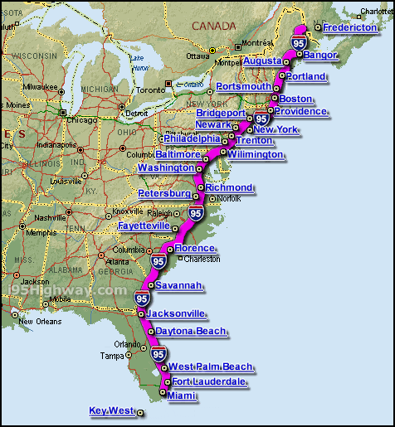
LOCAL TRAFFIC/ENVIRONMENTAL
HAZARDS
Northern Virginia
  Four full weather seasons
  Most complex RUSH HOUR in USA
  2nd most dangerous place to drive in USA
Interstate 95/Rt. 1/66/207
  Lifeline of the East Coast (1907 miles long) MSR
  Crashes/construction/Accidents
    Rubbernecking
  Rush hour traffic
  Tractor Trailers
  Ice on roads (Black Ice)
Express HOV/HOT Lanes (EZ PASS)
  Lanes run BOTH directions
Capital Beltway
  Completely encircles the Nations Capital
  Inner/Outer Loop/63.8 miles long
  Heavy congestion
VA “ Move Over Law”
  Section 46.2-921.1 of the Code of Virginia states:
  46.2-921.1. Drivers to yield right-of-way or reduce speed when approaching stationary emergency vehicles on highways; (flashing, blinking, or alternating blue, red, or amber light or lights)
MCBQ TRAFFIC HZDS
  Quantico Train Tracks
    Obey RR signals
    Traffic light delay
  Barnett Ave Crosswalks
  Running on Fuller Rd.

Slide 14
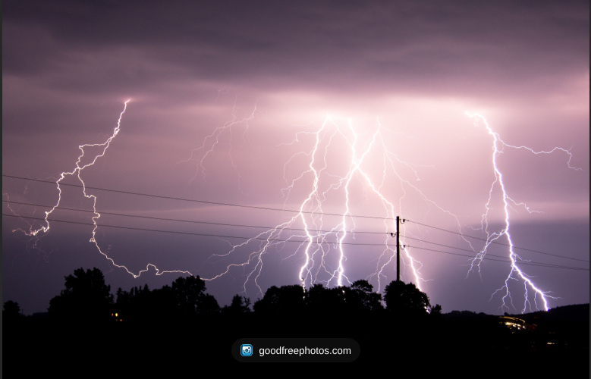
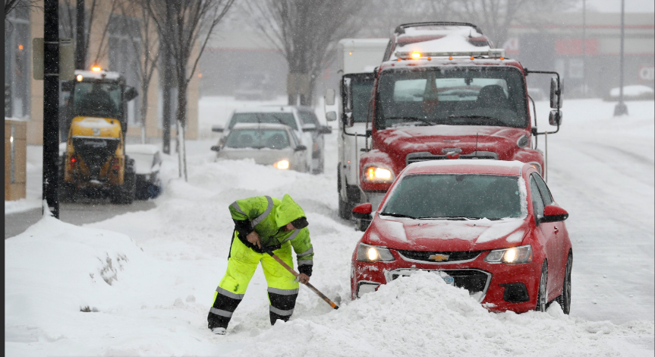
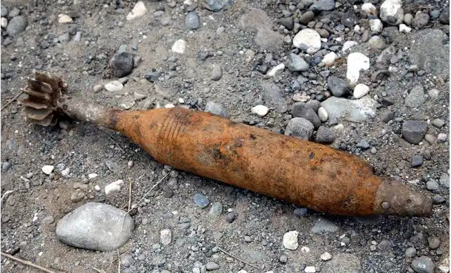
WEATHER AND RECREATIONAL/OFF DUTY
HAZARDS
Inclement Weather
  Lightning/Heavy Rain
  Snowstorms/Tornadoes
  Flooding
Hiking/Camping/Wildlife
Rafting/River crossing/Water Hzds
On Base Hzds - UXO
  Running trails – be vigilant!
    Use 3 R’s – Recognize, Retreat, Report
  Lunga Recreation Area
    1st section re-opened CY23
    Large portion still closed for UXO clean-up
Crime
  Baltimore
  D.C.

Slide 15
UNIT SAFETY OFFICER POC’s
MCCS
  Kevin Guy - kevin.guy@usmc-mccs.org
SECURITY BN
  Patrick Abair - patrick.r.abair.civ@usmc.mil
TECOM
  Maurice Jones - maurice.jones@usmc.mil
  Barbara Williams - barbara.williams@usmc.mil
TBS
  Scott Davis - scott.a.davis5@usmc.mil
MCAF
  David Luther - david.luther@usmc.mil

Slide 16
QUESTIONS?
For more info contact
the main office or send us an email at
QUANTICO_SAFETY@usmc.mil
(703) 784-2866
Notes:
Questions

